Slide 1
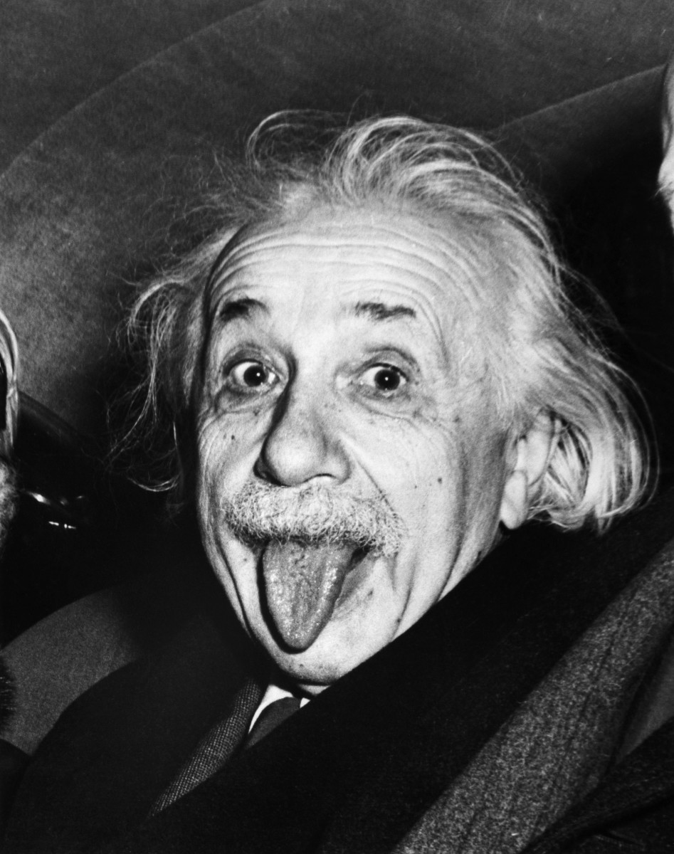
PROJECT 1 TURTLEBOT EINSTEIN
ECE 478, PHONG NGUYEN, ALI BOSHEHRI
Video document:
https://www.youtube.com/playlist?list=PLxiXRkFUM1W4GCAMjMz7DGA7DtuK4A1gv

Slide 2
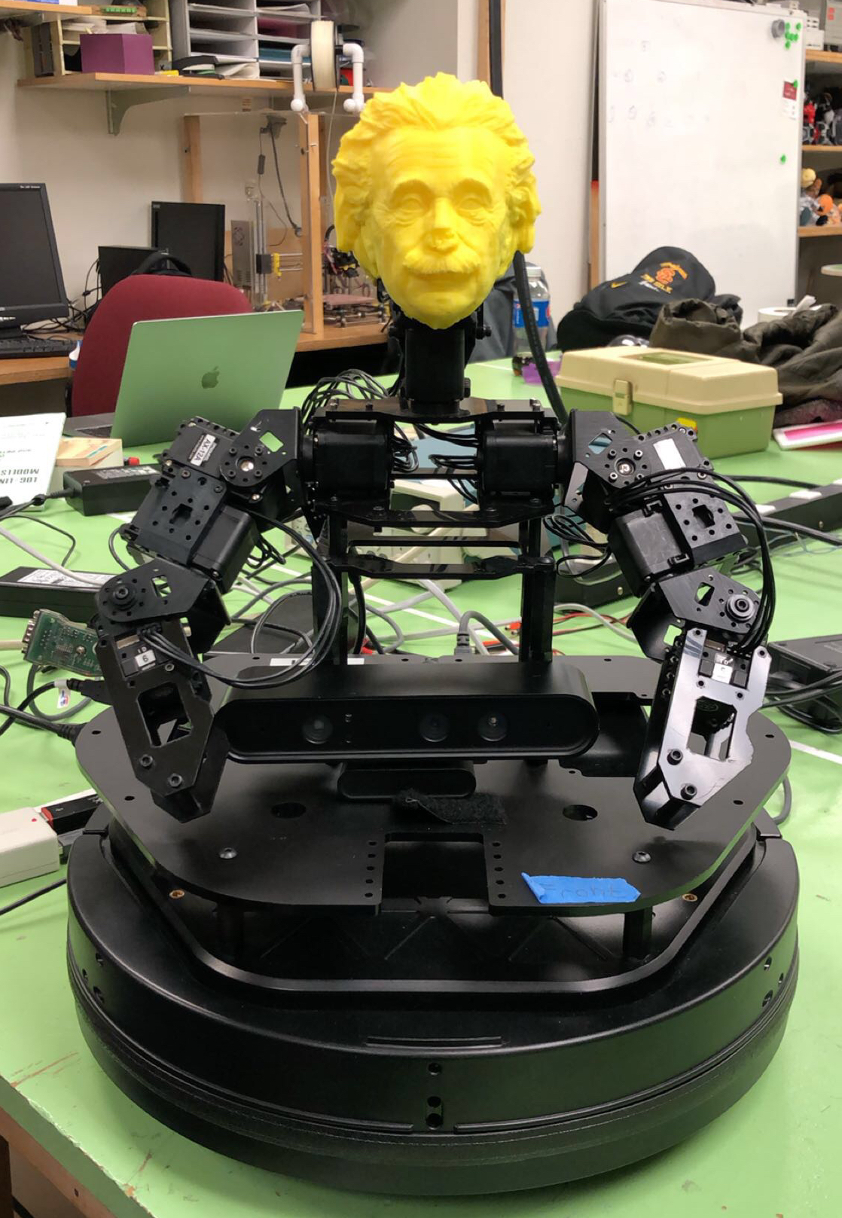
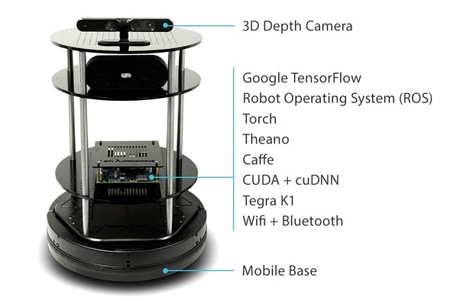
TURTLEBOT PROGRAMING WITH ROS

Slide 3
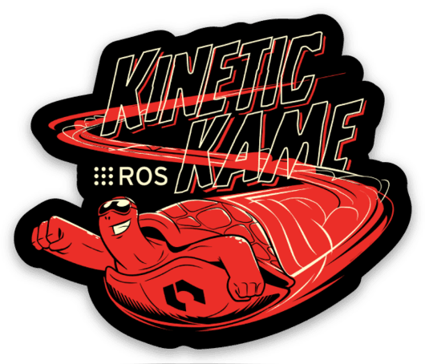
ROS
Software framework for programming robots
Prototypes originated from Stanford AI research in 2007
Consist of 4 things: infrastructure, tools, capabilities, and ecosystem
Open source robotics foundation

Slide 4
PREREQUISITES INSTALLATION
Ubuntu linux 16.04
ROS kinetic + libraries and dependencies
A fairly fast computer if run with simulation
Knowledge of programing in Python or C++

Slide 5
DYNAMIXEL SERVOS
Initializations the servos using RoboPlus 1.0 (Dynamixel Wizard)
Set the limits
Connect to ROS

Slide 6
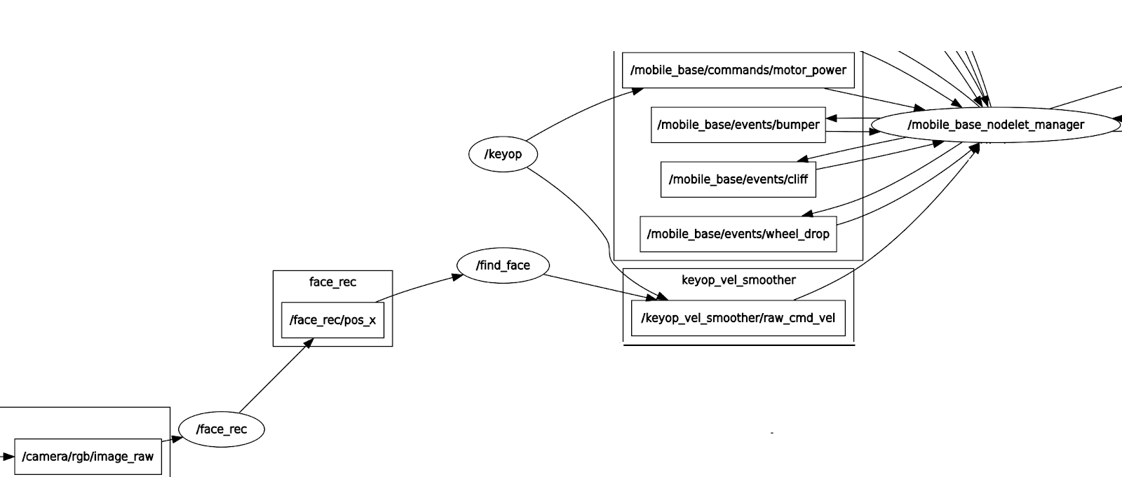
FACIAL RECOGNITION

Slide 7
FACIAL RECOGNITION DEMO
https://www.youtube.com/watch?v=U1vhmMhQafo

Slide 8
BASE MOTION
Prompt the user
Go forward
Spin left
Spin right
Draw a square
Draw a triangle
Go back and forth
Circle counter clockwise
Circle clockwise

Slide 9
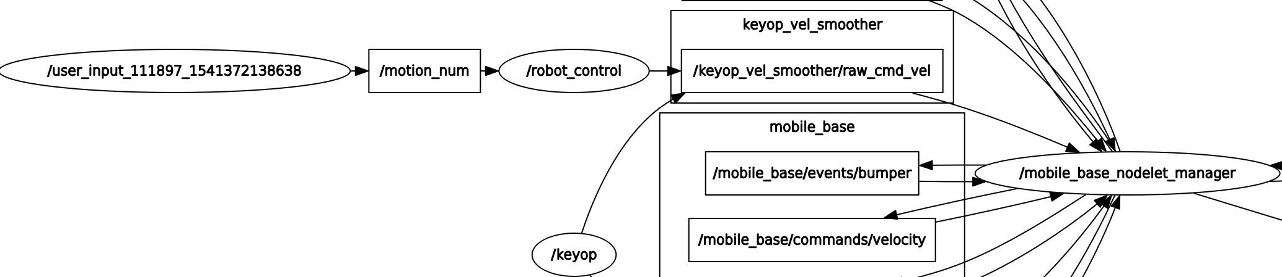
USER INPUT AND MOTION

Slide 10
Turtlebot Einstein - Project 2
ECE 478, PHONG NGUYEN, ALI BOSHEHRI

Slide 11
Objectives
Implement speech recognition into the robot by using Google Dialogflow.
Be able to have a small talk with the robot.
Implement speech synthesis into your robot by using Amazon Polly
We chose German accent to fit Einstein’s character.

Slide 12
Tools
ROS
Google Speech Recognition
DialogFlow
Amazon Polly

Slide 13
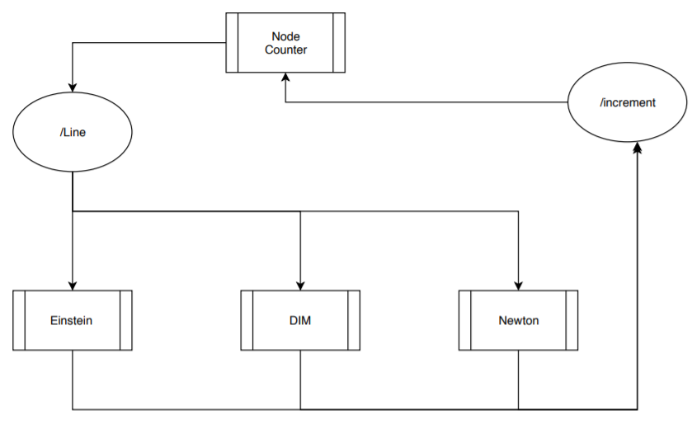

Slide 14
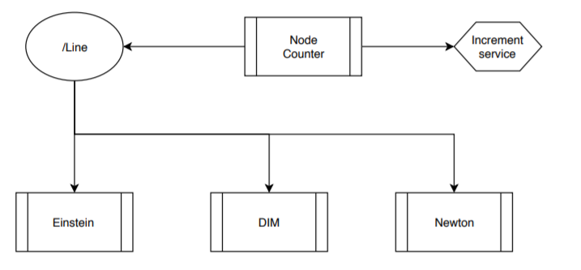

Slide 15
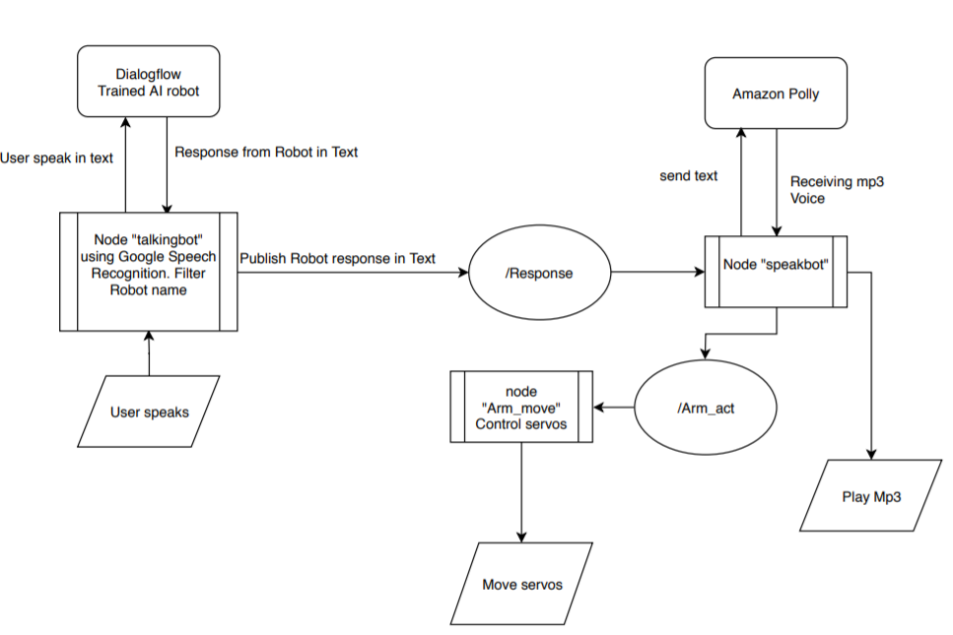

Slide 16
Testing Demo
https://www.youtube.com/watch?v=ZCAw9Dyp-fs&index=5&list=PLxiXRkFUM1W6W14SXuw2-cTAIUkM0oP4m

Slide 17
Questions?
THANK YOU

